Slide 1
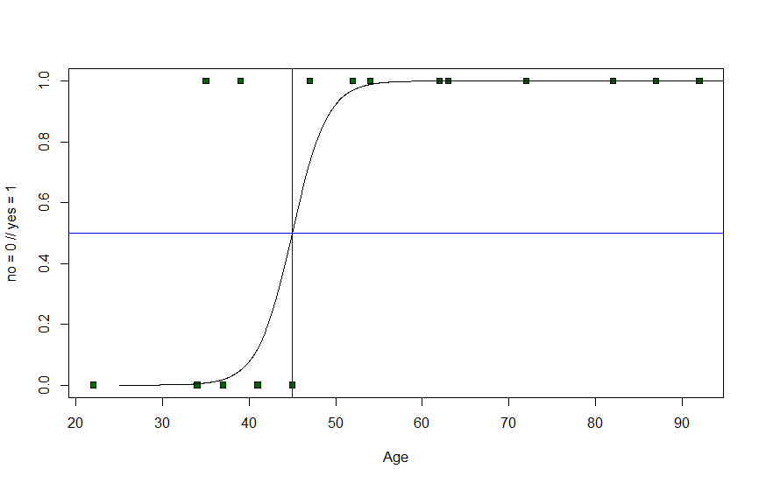
How to get the most out of this course

Slide 2
What does it take to become a data scientist?
Maths
and
Statistics
Machine
Learning
Traditional
Research
Computer
Science
Domain
Knowledge
Software
Development

Slide 3

What does it take to become a data scientist?
Math
and
Statistics
Machine
Learning
Traditional
Research
Data
Science
Computer
Science
Domain
Knowledge
Software
Development

Slide 4
What will you
learn in this course?
What will you
learn in this course?

Slide 5
Descriptive Statistics
What will you
learn in this course?

Slide 6
Measures of central tendency
Descriptive Statistics
Measures of spread
Kurtosis
Skewness
What will you
learn in this course?

Slide 7
Descriptive Statistics
Probability theory
What will you
learn in this course?

Slide 8
Descriptive Statistics
Distributions
Probability theory
Bayes Theorem
Expected value
Central Limit Theorem
Law of Large Numbers
What will you
learn in this course?

Slide 9
Descriptive Statistics
Probability theory
Hypothesis testing
What will you
learn in this course?

Slide 10
Descriptive Statistics
Probability theory
What is an hypothesis?
Hypothesis testing
Significance
Type I / II errors
p-value
What will you
learn in this course?
Confidence intervals

Slide 11
Descriptive Statistics
Probability theory
Hypothesis testing
Regressions
What will you
learn in this course?

Slide 12
Descriptive Statistics
Probability theory
Linear Regression
Hypothesis testing
Correlation
Regressions
Coefficient of determination
Residuals, MSE & MAE
What will you
learn in this course?
Root mean square error

Slide 13
Descriptive Statistics
Probability theory
Multiple Regression
Polynomial Regression
Hypothesis testing
Logistic Regression
Regressions
Over-/underfitting
Advanced Regressions
Decision Tree Regressions
What will you
learn in this course?
Decision Forests

Slide 14
Descriptive Statistics
Probability theory
Hypothesis testing
Regressions
Advanced Regressions
ANOVA
What will you
learn in this course?
Wrap

Slide 15
Preparing our Project
Data Transformation I
Data Transformation II
Advanced
Creating our Model
Visualizing Data
What will you
learn in this course?

Slide 16
Preparing our Project
Data Transformation I
Data Transformation II
Advanced
Creating our Model
Visualizing Data
Storytelling with Data
What will you
learn in this course?

Slide 17
Preparing our Project
Analyze with DAX
Data Transformation I
Data Transformation II
Advanced
Creating our Model
Visualizing Data
Storytelling with Data
What will you
learn in this course?

Slide 18
Preparing our Project
Analyze with DAX
Advanced
Data Transformation I
Data Transformation II
Advanced
Creating our Model
Visualizing Data
Storytelling with Data
What will you
learn in this course?

Slide 19
Preparing our Project
Analyze with DAX
Advanced
Data Transformation I
Power BI Cloud
Data Transformation II
Advanced
Creating our Model
Visualizing Data
Storytelling with Data
What will you
learn in this course?

Slide 20
Preparing our Project
Analyze with DAX
Advanced
Data Transformation I
Power BI Cloud
Data Transformation II
Advanced
Power BI Mobile
Creating our Model
Visualizing Data
Storytelling with Data
What will you
learn in this course?

Slide 21
Preparing our Project
Analyze with DAX
Advanced
Data Transformation I
Power BI Cloud
Data Transformation II
Advanced
Power BI Mobile
Creating our Model
Other Data Sources
Visualizing Data
Storytelling with Data
What will you
learn in this course?

Slide 22
Preparing our Project
Analyze with DAX
Advanced
Data Transformation I
Power BI Cloud
Data Transformation II
Advanced
Power BI Mobile
Creating our Model
Other Data Sources
Advanced
Visualizing Data
Storytelling with Data
What will you
learn in this course?

Slide 23
Preparing our Project
Analyze with DAX
Advanced
Data Transformation I
Power BI Cloud
Data Transformation II
Advanced
Power BI Mobile
Creating our Model
Other Data Sources
Advanced
Visualizing Data
How to continue
Storytelling with Data
What will you
learn in this course?

Slide 24
What you will learn?
Maths
and
Statistics
Machine
Learning
Traditional
Research
Data
Science
Computer
Science
Domain
Knowledge
Software
Development

